Slide 1


Don’t Get Taxed Out: Navigating the New Rules
Berks County Estate Planning Council
October 29, 2025

Slide 2
National Association of Estate Planners & Councils (NAEPC)
  Value Partners (flagship Trusts & Estates $149 subscription, only $99) - Discounts available, the authority on estate law, tax issues, and wealth management for over a century.
  Webinars – November 12, 2025, Financial Elder Care Abuse - Paul Greenwood
  Reduced pricing to attend annual conference, obtain CE, build national network of professionals *** STAY TUNED – Virtual 2026 – Spring 2027-LIVE
  Council Leadership Series – Virtual sessions – Recorded Events available
  NAEPC Journal of Estate & Tax Planning – published twice a year, original content from leading practitioners, latest October edition available
  Monthly Leimberg Newsletter on national website
  AEP Designation - https://www.naepc.org/designations/estate-planners

Slide 3
One Big Beautiful Bill Act – OB3
Signed by the President July 4, 2025
Makes many of the tax laws from Tax Cuts and Jobs Act permanent
In addition, introduced new tax laws – which will start in 2025 and some in 2026, with some of these new laws being temporary

Slide 4
Income Tax Rates, Exemptions and Deductions
All income tax rates and bracket thresholds are made permanent
Standard deduction remains increased
Personal exemptions are permanently terminated
Estate Tax Exemption – starting in 2026 will be at $15 Million – permanent increase – NO sunset

Slide 5
New Deductions – Senior Deduction
Starts for tax year 2025 through 2028
Taxpayers that are age 65 by December 31 of the current tax year
Additional deduction $6k for Single and $12k for joint - allowed if you itemized or if you take the standard deduction
Income limitations –phaseout starts if AGI is greater than $75k single and $150k joint. If AGI exceeds $175k single and $250k joint – no deduction
No deduction allowed for MFS

Slide 6
New Deductions – Increase in SALT
Starting in 2025 through 2028 – new increase in State and Local Income Tax – previously at $10,000 now at $40,000
If AGI is greater than $600k, there is no additional deduction, limit is $10,000
If AGI is between $500k and $600k, the deduction is reduced by 30% for the amount over $500k

Slide 7
New Deductions – Educator Expenses
Previously – educator expenses was an adjustment to AGI with a limit of $300
Now, unlimited amount of educator expenses but this is a miscellaneous deduction (not limited to 2%).
However, only benefit if the Taxpayer itemizes on their return. No benefit if the standard deduction is taken.
Deduction allowed starting in 2026

Slide 8
New Deductions - Charity
Starting in 2026
Additional deduction to AGI for taxpayers taking the standard deduction. If taxpayers make cash donation, an additional deduction is allowed for the amount of the donations limited to:
$1k for Single and $2k for joint
If Taxpayers are more charitable – grouping deductions and QCDs should be utilized

Slide 9
New Deductions – Limitation on Charitable Giving
New Complexity starts in 2026
.5% of AGI floor amount – is not deductible
Example:
- Taxpayer has $500,000 of AGI
- Charitable donations of $10,000
.5% floor = $2,500
2026 – donation is $7,500
In 2027, the delta between PY .5% floor amount, if AGI is $540,000, new amount is $2,700, if itemized in both years, amount not deductible is $200

Slide 10
New Deductions – Limitation on Itemized Deductions
New Complexity starts in 2026
Permanent repeal of the PEASE limitation
Only applies to the 37% tax bracket – 2026 brackets– TI ~$640k Single and ~$770k Joint
Lessor of:
- Reduction of 2/37% of total itemized deductions
- Total taxable income, plus itemized deductions, subject to the 37% tax bracket
**Application to Fiduciary Returns is unclear

Slide 11
New Deductions – Limitation on Itemized Deductions and Charity Combined
Example:
2026 – Taxpayer AGI of $1M
Donations of $105,000 – only deduction T/P is taking
First reduce the contribution base by .5%
.5% of $1M is $5k – deduction of $100k
2/37 itemized deduction reduction
Lessor of:
2/37 of $100k = $5,405
2/37 of $350k excess = $18,519
Charitable deduction of $100k is reduced by $5,405 to arrive at $94,595

Slide 12
New Deductions – Tip Income
Starts in 2025 through tax years 2028
Above the line deduction up to $25,000
Deduction is allowed for both standard and itemized deductions
Tip income has to be customary. No deduction allowed for specified service businesses and no deduction allowed for MFS.
Tip income has to be discretionary and can’t be a stated required gratuity.
AGI of $150k single and $300k joint

Slide 13
New Deductions – Overtime Income
Starts in 2025 through tax years 2028
Above the line deduction of $25,000
Deduction is allowed for both standard and itemized deductions
Qualified Overtime Pay pursuant to the Fair Labor Standards Act of 1938
- Following are examples of employees exempt from overtime requirements: Executives, professionals, administrators, certain seasonal workers, certain farmworkers and certain commissioned retail employees
Excludes Qualified Tips
Excludes highly compensated employees
AGI of $150k single and $300k joint

Slide 14
Newborn Pilot Program – Trump Accounts
New Accounts for individuals born in 2025 through 2028
New account for the individual in the amount of $1,000
Account established for the individual when the first tax return is filed reporting the new taxpayer.
Treasury notifies of the new account and can be declined.

Slide 15
New Tax-Deferred Investment Accounts for Children – Trump Accounts
Child must be a U.S. Citizen, any child under age 18 is eligible to set up an account but only newborns will receive $1k deposit.
Account eligible to receive contributions from parents, relatives, parent’s employer ($2500) and other entities.
Contributions limited to $5,000 annually of after-tax dollars.
No distributions until age 18

Slide 16
New Tax-Deferred Investment Accounts for Children – Trump Accounts
From the White House – Next Generation –Jump Start on Saving
Within each contribution scenario, three alternative assumptions about future returns are considered—low, medium, and high—calculated as described above.
-Under the medium-returns scenario, this yields a balance of $303,800 by age 18 and $1,091,900 by age 28 under the maximum annual contribution scenario as described above. If the annual deposit is instead half of the maximum amount, the balance is $154,800 by age 18 and $555,000 by age 28. Finally, if no annual contributions are made, the account balance will still be $5,800 by age 18 and $18,100 by age 28.
-Even under the low-returns scenario, the account balance is $187,400 by age 18 and $772,200 by age 28 under the maximum annual contribution scenario.
-Under the high-returns scenario, these numbers jump very significantly to $730,400 by age 18 and $1,904,300 by age 28.

Slide 17
New Deductions – Businesses–Starting in 2025
Bonus depreciation is back to 100% on qualified property (asset must be placed in service after January 19, 2025
100% expensing for qualified production property, defined as nonresidential real property used directly in domestic production activities.
Domestic R&D expensing – reinstated for immediate deduction. Including previous R&D expenses that were capitalized. Special rules for businesses under $25M in revenue, deducted retroactively by amending.
Modifications to 163j interest limitations – back to the original law where the interest deduction is based on income before depreciation, depletion and amortization

Slide 18
New Exclusions – Qualified Small Business Stock (QSBS)
50% gain exclusion for stock held 3 years, 75% if held 4 years and 100% if held for 5 years
Cumulative exclusion limitation was increased from $10M to $15M
Aggregate gross asset increased from $50M to $75M, indexed for inflation

Slide 19
Where are we at Currently
  Increased permanent estate tax exemption
  Relatively low tax rates – permanent
  Limited tax deductions
  Business / economic environment
  Need to focus on income tax planning

Slide 20
Estate Tax Planning
Valuation discounts
Donating Capital Gain Property
Increase in interest rates – might give hesitation for certain transactions that we have been taking advantage in the past with the low interest rates for purposes of family loans, note sales, GRATs (Nov rate 4.6% - GRATs and 4.62% LT APR)
QPRT – Qualified Personal Residence Trust
Reviewing previous Trusts (CST) to see if needed since increase Exemption
Best planning done as a TEAM!

Slide 21
2025 Tax Year – Y/E Considerations
Energy tax credits from Inflation Reduction Act have been terminated early, still claim credits in 2025 relating to residential energy efficiency improvements, clean energy and some EV purchases.
Excess business losses now effective through 2028 (loss limitation of $313,000 /$626,000 MFJ for 2025)
Age for RMD for 2025 – Age 73
RMD for inherited IRA is required in 2025
Starting in 2024, new provision that allows funds from 529 plans to be rolled over into Roth IRAs
Charitable Donations
Form 1099-K reporting requirements, for 2025 threshold will be $20,000 AND 200 transactions are reported.

Slide 22
Charitable Donations
Important to make timely deductions – not necessarily to accelerate – increased standard deduction
Donor Advised Funds - DAF
Contribution of appreciated assets
Qualified Charitable Distributions from IRAs

Slide 23
Charitable Deductions – Recent Case Law
Uncashed gifts checks
Checks gifted to family members, but the checks were cashed after the donor died; not a completed gift, includable in the Estate. (Estate of DeMuth, Jr (CA3) 132 AFTR 2d)
Be careful with checks being written at the end of the year for the annual exclusion, if not cashed by 12/31; not a completed gift.

Slide 24

Secure 2.0 Act

Slide 25
SECURE 2.0 – Encouragement of New Plans and more participants
Automatic enrollment in new retirement plans
Faster eligibility for long-term, part-time workers
Tax credits for starting a new plan – ERs up to 50EE, increase credit to 100% of expenses, capped at $5,000
Additional credit for ER match- per EE cap at $1,000
Increase to Saver’s Credit- contribution to retirement account

Slide 26
529 Plan Rollover
Allows for a rollover from a 529 plan to a Roth IRA
529 Plan must be maintained for 15 years before the rollover
Roth rollovers limited to the aggregate contributions (and attributable earnings) made at least 5- years before the date of the distribution
Rollover limited to the $6,000 contribution limit (adjusted for inflation) -Regular IRA contributions reduce eligible 529 rollovers - Roth income limits don’t seem to apply -Overall aggregate lifetime limit of $35,000
New under OB3 – expansion of distributions for grades K-12 is now $20,000

Slide 27
Higher Catchup Limits
Indexing IRA catch-up limit for inflation starting in 2024
Currently $7,500 for ages 50 and over for retirement plans – 401(k), 403(b), 457(b)
Increase to $10,000 aged 60-63 (but not 64), starting in 2025, subject to inflation, ALL CATCHUP CONTRIBUTIONS ARE ROTH

Slide 28
Tax Planning for Business Owners
*Retirement Planning*
State and Local Taxes
Work around the SALT $10,000 / $40,000 deduction
November 2020 – IRS Notice – 2020-75
Pass Through Entity Tax in many states

Slide 29
Income Tax Planning
Retirement planning – increase deductions in 2025, maximizing contributions
Bonus Depreciation – placing assets in service
Qualified Business income deduction – review taxable income, retirement contributions can decrease your income, causing a taxpayer eligible for 199A deduction
Review the full picture of current year and projecting to the following, analyzing the tax impact with tax law changes
Business owners – unreimbursed business expenses

Slide 30
Income Tax Planning – Retirement Plans
Benefits include:
New retirement credits for new plans
Incentive for staff and retaining employees
Planning to maximize retirement contributions and deductions
Build upon the standard retirement plan – adding a Cash Balance Plan – provides flexibility, can assist with Buyouts

Slide 31
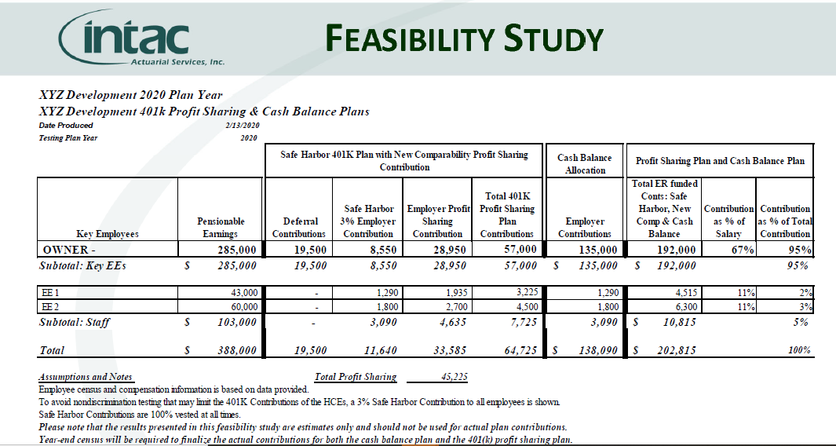
Income Tax Planning – Retirement Plans

Slide 32
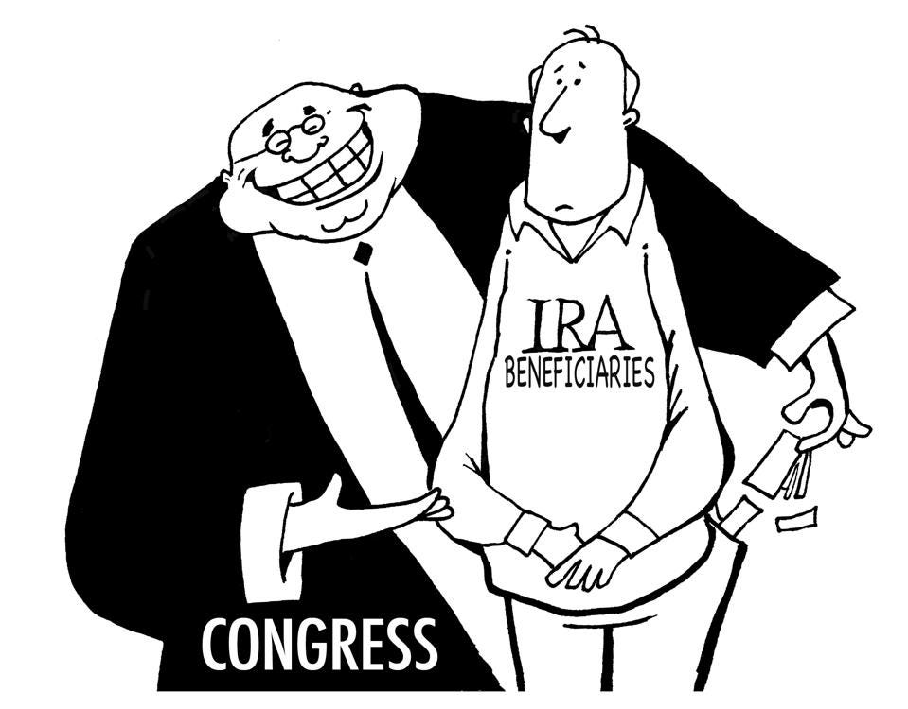
SECURE Act
RANDY BISH - Forbes

Slide 33
IRA Planning
Most likely tax rates will increase in future years, opportunity to take advantage of a Roth IRA conversion. Possible benefit to complete a Roth IRA conversion based on tax law changes.
SECURE Act eliminates the “stretch IRA”
New concern for clients with substantial retirement accounts
All inherited IRAs starting January 1, 2020, you can no longer stretch your distributions
For non-spousal inherited IRAs – must be distributed within 10 years
Exceptions – minor child, less than 10 years younger than original owner and disabled/chronically ill
Market volatility – beware - no longer can reverse the conversion

Slide 34
IRAs – Final Proposed Regs Issued – IRS Notice 2022-53 and 2023-54 - IRA Beneficiaries - RMD requirements
Previously there was uncertainty if RMDs were required to be taken during the 10 year period.
Proposed Regs clarify the rules on RMDs
Final Regs issued – effective Sept 17, 2024
Excise tax on RMDs not taken for a non-spousal IRA beneficiary inherited after 2019 – there is NO pentaly for tax year 2021, 2022, 2023 and 2024
You do not need to go back to make up missed RMDs for previous years

Slide 35
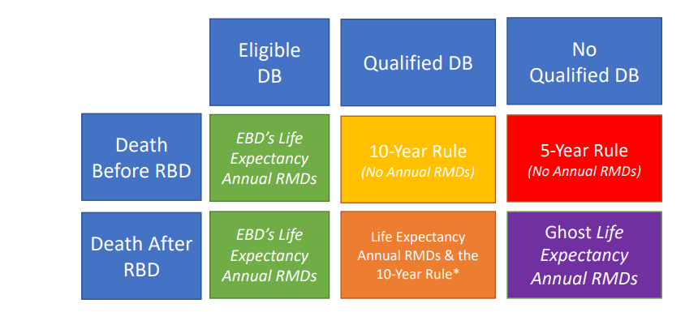
IRAs – NOTICE 2022-53
IRA Beneficiaries - RMD requirements – General Rules

Slide 36
IRAs – NOTICE 2022-53
IRA Beneficiaries - RMD requirements – Definitions
RMD – Required Minimum Distribution
DB – Defined Benefit
RBD – Required Beginning Date – date you must start receiving your retirement benefits
EDB – Eligible Designated Beneficiary – surviving spouse, minor child, disabled person, etc.

Slide 37
IRA Planning- Example– Taking $ out over 10 years vs. Year 10
 | Distribution | Distribution | Post Dist | Value | Tax |  | BOY | EOY | Tax
1 | 100,000 | 900,000 | 900,000 | 936,000 | 86,039 |  | 1,000,000 | 1,040,000 | 54,265
2 | 103,990 | 832,010 | 832,010 | 865,291 | 87,717 |  | 1,040,000 | 1,081,600 | 54,265
3 | 108,161 | 757,129 | 757,129 | 787,415 | 89,512 |  | 1,081,600 | 1,124,864 | 54,265
4 | 112,488 | 674,927 | 674,927 | 701,924 | 91,316 |  | 1,124,864 | 1,169,859 | 54,265
5 | 116,987 | 584,937 | 584,937 | 608,334 | 113,632 |  | 1,169,859 | 1,216,653 | 74,022
6 | 121,667 | 486,667 | 486,667 | 506,134 | 115,223 |  | 1,216,653 | 1,265,319 | 74,022
7 | 126,533 | 379,600 | 379,600 | 394,784 | 116,877 |  | 1,265,319 | 1,315,932 | 74,022
8 | 131,595 | 263,190 | 263,190 | 273,717 | 118,598 |  | 1,315,932 | 1,368,569 | 74,022
9 | 136,859 | 136,859 | 136,859 | 142,333 | 120,387 |  | 1,368,569 | 1,423,312 | 74,022
10 | 142,333 | - | - | - | 122,248 |  | 1,423,312 |  | 631,037
Totals | 1,200,613 |  |  | (661,192) | 400,357 |  | 1,423,312 | (661,192) | 762,120
 |  |  |  |  | Net after tax |  |  | Tax | Net after tax
Same income over 10 years |  |  |  |  |  |  |  |  | $361,763
Wages |  |  | 250,000 | Std deduction | Sch C | 80,000 |  | Earning 4% | Add’l Funds

Slide 38
ROTH IRA CONVERSIONS
SECURE – elimination of the stretch IRA
Offset in increased charitable contribution deduction (100% of AGI)
Payment of tax – reduces estate
Possible increase in tax rates in the future

Slide 39
Roth IRA Conversion
Example – Reduce Retirement Asset
Converting a small portion - $50k over a few years
Benefit to contributing a portion over many years – growing the tax free bucket
Paying tax – reducing estate – offsetting income with charitable donations
Taxpayer 75, spouse deceased, beneficiary – daughter (age 48)
Plan is to convert $50k to Roth over next 10 years
Retirement asset $2 M in 2022
Roth IRA grows with conversion and 4% rate of return - $800k at age 90
Taxable retirement account is $1.6M at age 90 (ASSUMPTION NOTHING IS DONE)
If Taxpayer passes away at age 90, completing the Roth conversions, daughter inherits taxable account of $1.174 M and Roth of $790k; more accumulation due to RMD decreasing as funds are transferred to the Roth account.

Slide 40
Roth IRA Conversion
Example - Proactive Planning
Retiring early at age 62
Retirement assets are $1.75 M; Projected RMD $102,000
Converting to a Roth IRA over the 10 years which will reduce the taxable retirement asset and ultimately reducing their RMD which they will be at age 73
Rate of return – 6%; no contributions, small distributions for living expenses - $30k to $55k; Convert around $47k a year to a Roth IRA
At age 73 – Traditional IRA account ~$2.1M and Roth at $627k; RMD is $77,500
Reduction in RMD ($24k) from $102k to $78k; savings of $6k in tax; Utilizing a lower tax bracket when completing the Roth conversions
Overall since their RMD is lower, less taxes will be paid

Slide 41
Roth IRA Conversion
Example - Proactive Planning
Taxpayer and spouse 48
Taxable retirement assets are $500k
Convert to a Roth IRA in 2022 – Pay federal $185k and $65k = $250K tax
Convert a portion over time – next 3 years – lower tax rates, possible lower values due to market
Rate of return – 5%
Roth IRA can grow to $1,930,000
Federal taxes if left in a taxable retirement account to be $888k (46%)
Less taxes will be paid and provide more flexibility

Slide 42
Growing the Tax-Free Bucket
Back Door Roth IRA Contributions
Making a contribution to a Traditional IRA – nondeductible
Converting that IRA to a Roth
Mega Backdoor Roth / Super-Roth
Benefits:
Tax free growth and withdrawal
No RMD
May help taxability of social security income and Medicare premium cost
Tax-free income for beneficiaries
Reduce taxes and Net investment income tax (lower income)

Slide 43
Additional Alternatives due to the elimination of the Stretch IRA
Consider Alternative investment vehicles – purchase of life insurance
Life insurance in an Irrevocable Trust
IRA Trusts
Selecting the proper state – lower income tax rate at state level
Life insurance under IRC 7702 – provides tax-free access and income strategy using Variable Life Insurance (ALTERNATIVE TO ROTH IRA)
Charitable Remainder Trust
  Fund the trust with the IRA asset at death
  Income stream from the trust to the beneficiaries (rising interest rates – increases the income stream)
  Assets are taxed when distributed from the trust
  Deduction claimed by the estate

Slide 44
Net Unrealized Appreciation (NUA)
Employer retirement plan- concentrated position of employer stock
Make a lump-sum distribution of the plan assets
Cost basis of the stock is ordinary income
Appreciated value is taxed as a capital gain, at the time the stock is sold
Need to be of retirement age, or else the distribution is subject to the 10% penalty
Needs to be done from an employer sponsor plan and not rolled over into an IRA

Slide 45

Additional guidance will hopefully come out to provide some clarity.
Please reach out if additional
assistance is needed
Rachel Votto, CPA, AEP
rvotto@bdgcpa.com
201-652-4040
Thank you!

