Slide 1
Title Slide
Welcome

Slide 2

How to Avoid and What to do If Audited by the IRS on an Estate or Gift Tax Return
Berks County Estate Planning Council
January 25, 2017
Michael Gregory
Michael Gregory Consulting LLC

Slide 3

Mike Gregory
Background
Qualifications
Notes:
Presenter
Michael Gregory, Chief Manager, Michael Gregory Consulting, LLC since 2011
Formerly IRS 28 Years as Specialist, Manager, Operations Team Lead, Controller, Acting Assistant District Director, Territory Manager
Qualified Neutral Supreme Court in MN, ASA, CVA, and MBA

Slide 4

Mike Gregory
mg@mikegreg.com
www.mikegreg.com
www.mikegreg.com/blog
651-633-5311
10 books and 14 Videos

Slide 5

Disclaimer
The opinions presented here are those of Michael Gregory. Michael Gregory does not represent the IRS. Any opinions presented in this seminar are those of the author and do not represent an official position of his current or previous employers. This material is offered for educational purposes only. The author and his employer expressly disclaim any liability, including incidental or consequential damages, arising from the use of this material or any errors or omissions that may be contained in it.

Slide 6


Get Behind the IRS
Discussion and Questions
Notes:
Understand IRS Divisions
Two Real World Examples to Set the Stage
Some Words About Neuroscience
Understand Who the Players Are
Issue Resolution at the IRS
10 Most Common Mistakes by Taxpayers on Gifts
Additional Items to Consider & Important Take-Away Information

Slide 7

Understand the IRS
Notes:
Understand the IRS
1913 to 2000 National Office, Regions and Districts
2000 Forward 13 Divisions
Two for Internal Clients
Eleven Divisions for External Clients
Wage and Investment –W&I (1040s)
Small Business Self Employed SBSE (assets < $10M)
Large Business and International (assets > $10 M)
Tax Exempt and Governmental Entities

Slide 8

Two Real World Examples
Valuation
Classification
Notes:
Two Real World Examples
Discount for Lack of Marketability 10% IRS and 30% Taxpayer (Hybrid Example of Several Cases with Points Being Made)
Think of This as Four Quarters in a Meeting
Relationship, Listening
Education, Negotiation
Don’t Underestimate Neuroscience
Filing for Multimillion Dollar Estates
How to Prepare Administratively
How to Prepare Technically

Slide 9

Thanks Neuroscience
Ericka Garms, PhD U of MN and Her Team, Neuroscientist
John B. Molidor, PhD Assoc. Dean MSU Medical School
Rick Hanson, PhD Psychologist, Greater Good U of CA Berkeley
Jeremy Hunter, PhD Practice of Self Management U of Chicago
Douglas E. Noll, JD MA, Mediator and Attorney

Slide 10

IRS Audit Categories
Examination IRS Document 6036
  1120 – No Balance sheet to over $20B in Assets -14 categories
  1120S 4 categories by Assets
  1120F – 3 categories by Assets
  1040 -14 categories by Income
  1041 – 4 categories by taxable and non-taxable
  1065 – 5 categories
  Employment tax – 9 categories
  Excise – 64 categories
  Miscellaneous Forms (990’s) – 8 categories
  Estates – 8 categories by Assets
  Gifts – 6 categories by Assets and Other Codes

Slide 11

Estate/Gift Tax Audit
Estate and Gift (E&G)Tax Attorneys in the Small Business and Self Employed Division (SBSE)
Business Valuators in Engineering
Notes:
Who are you most likely to interact with in an Estate and Gift Tax Audit Situation?
Estate and Gift (E&G)Tax Attorneys in the Small Business and Self Employed Division (SBSE)
Business Valuators in Engineering

Slide 12
Historical Perspective of E&G Filings and Audits
Category | Year | Year | Year | Year
 | Totals | % Audited | Totals | % Audited
 | 2013 | 2014 | 2014 | 2015
< $ 5 Mil | 23,722 | 2.3% | 25,188 | 2.1%
$5M<x<$10M | 6,588 | 21.1% | 6,916 | 16.2%
>$10 Mil | 3,359 | 27.0% | 3,515 | 31.6%
Estate Totals | 33,719 | 8.5% | 35,619 | 7.8%
Gift Totals | 371,747 | 0.8% | 267,600 | 0.9%

Slide 13

Classification
National
Local

Slide 14

Classification Selection
Demand Pull
Independent
Specialist
Notes:
Selection of Cases
Demand Pull
Independent
Specialist Consultant

Slide 15

Two Examples
Publication 1
  38 States
Specialist
  Jargon
  Common Ground
Notes:
Real World Examples at the Examination Level
SBSE Examination Case with a Business Valuation Issue-Publication 1 Concerns
Assisted in over 38 States on this Issue
SBSE Examination Case with a Business Valuation Issue and a Valuation Specialist
Specialist and Appraiser Speak the Same Jargon
Work to Find Common Ground

Slide 16

Information Document Requests
(IDRs)
LB&I Control No: LB&I-04-0214-004
SBSE
SBSE Examination Case with a Process
  Valuer and ETA
  ETA and ETA Manger
  ETA Manager

Slide 17

Manage
Audit
Relationship, Listening, Educating, Negotiating
Example of $50 M Taxpayer

Slide 18

Mediation
FIFI
  Facts
  Issues
  Feelings
  Interests
Notes:
LB&I has an Informal Mediation Process – SBSE Uses This Too
Specialists Trained in Mediation
Informal Process
Model – FIFI
What are the Facts?
What are the Issues?
How do you Feel (emotions of the parties) about this?
What are your Interests?
Once these are identified, we can explore solutions.

Slide 19

Appeals Process
Preparation
Professional
Help/Educate
Offer to do Computations
Summarize Issues – FIFI

Slide 20
IRS Appeals
Three Scenarios
Notes:
No appraisal
Review with an opinion of value
Appraisal internal or outside fee appraiser

Slide 21

Litigation
Overview U.S. Tax Court Process
  Report for the Judge
  Understand Roles
  New Report Consistent with Rule 702
  Timing
Notes:
Litigation
Quick Overview U.S. Tax Court Process
Prepare a Report for the Judge
Understand Roles of Attorney and Appraiser
Write a New Report Consistent with Rule 702
Understand Timing with Litigation
Quick Process Check with U.S. Tax Court
Overloaded and Overworked
A Very High Percentage Settle but You Never Know
Let Go to Bite Harder
Issue Resolution Still Works

Slide 22

Issue Resolution Examples
High Wealth Example
  IRS Mission
LB&I and SBSE Planning

Slide 23
Top Ten Most Common Mistakes Made by Taxpayers on Gifts
Not Having a Qualified Appraisal Made by a Qualified Appraiser- Notice 2006-96
Not Attaching the Appraisal to the Return
Appraisal Not Explaining Rationale for a Lay Person
Explanation for Developing Specific Discounts and Reconciling Approaches Are Inadequate
Assumptions and Limiting Conditions Are Boiler Plate and Not Consistent with the Appraisal

Slide 24
Top Ten Most Common Mistakes Made by Taxpayers on Gifts
Rationale for Discount Rate on Income Approach Not Fully Developed for Facts
Market Approach without Good Guideline Companies and Treating Market Data Bases as if Good Guideline Companies
Explanation Reconciling Income, Market and Cost Approaches Inadequate
When Audited Not Preparing Properly and Developing a Relationship
Understanding the Systems Involved During an Audit and How to Work with the IRS

Slide 25
Statute of Limitations on a Gift Tax Return
Form 709 Three Years After Filed Timely and Adequately Disclosing the Gift
If No Gift Tax Return is Filed then the Statue Does Not Exist – Pursue Indefinitely
If Not Adequately Disclosed the IRS can Pursue Indefinitely
Statue Can Have Expired, but May Be Revalued by the IRS

Slide 26

Important Take Away Information
Relationship
Know Who Your Working with
Role of Participants
Understand Interests
Ask Questions
Options
  Specialist
  Elevate Management

Slide 27


Unlocking Private Company Wealth
by
Z. Christopher Mercer

Slide 28

Important Offer
Send Me Your Email Address and I’ll Send You
  Newsletter
  Three IRS Job Aids on Reasonable Compensation, Valuing Non-Controlling Interests in S-Corps, Discounts for Lack of Marketability
  Latest from the IRS on the IRS Future State and Transfer Pricing
  IRS Directive on IDR’s-Information Document Requests
Don’t want Newsletter – NO TIPS

Slide 29

www.mikegreg.com

Slide 30
How to Work with the IRS,
Second Edition
How the Content of this Book and My Experience Can Help You
Understand the IRS Official and Unofficial Rules of Engagement
Use the IRS Official Organization to Your Advantage
Understand Classification in General and Estate & Gift Tax in Particular
Working with Technical Specialists at the IRS
Discover the Issue Resolution and Mediation Processes at the IRS
Using the IRS Evaluation Process to Your Advantage
How to Work with Expert Witnesses
Applying Strategic Thinking to Your Firm
Follow These Golden Rules When Working with the IRS

Slide 31
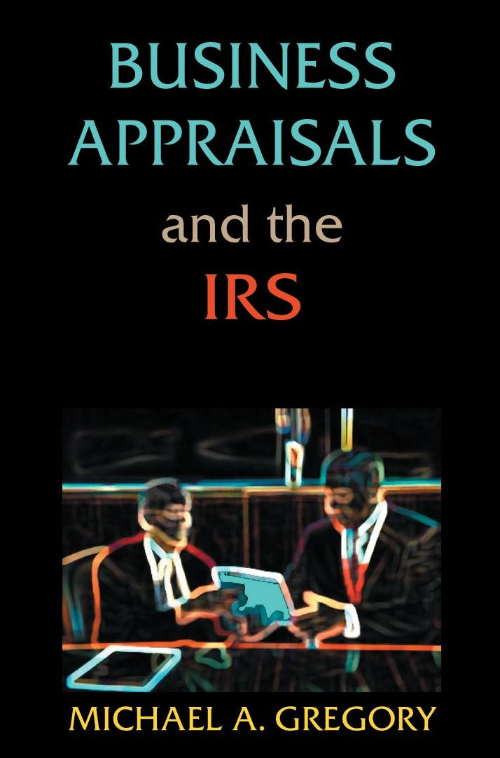
www.mikegreg.com

Slide 32
Business Appraisers and the IRS
1. Overview of Chapter Contents
2. Classification in General and in Estate and Gift Tax in Particular
3. Writing a Business Valuation Report for IRS Tax Purposes
4. Potential Penalties on Appraisers
5. Considerations in Valuing Interests in Subchapter S Corporations
6. How to Address Reasonable Compensation in Corporations
7. Code Section 409A and Valuators
8. Discount for Lack of Marketability and How to Approach the Issue
9. Most Common Errors in Valuations and How to Avoid Them
10. Potential Growth Areas for Business Valuation Appraisers
11. How to Work with the IRS to Resolve Differences in Valuation
12. Key Take-Away Items for Business Valuation Appraisers

Slide 33
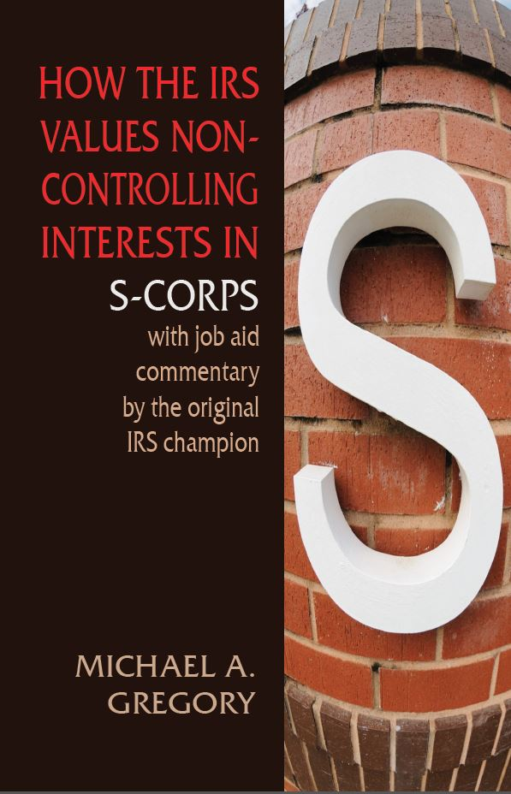
www.mikegreg.com

Slide 34
How the IRS Values Non-Controlling Interests in S Corps with Commentary by Original Champion
Part 1
  Overview of S Corps
  Key Court Cases
  Key Models
  Recommendations To Help with IRS Issues on Topic
Part 2
  IRS Job Aid on Valuing Non-Controlling Interests on S Corps on the right side
  Comments for Your Consideration Tying Into Part 1 To Clarify and Assist the Business Valuer on the left side

Slide 35
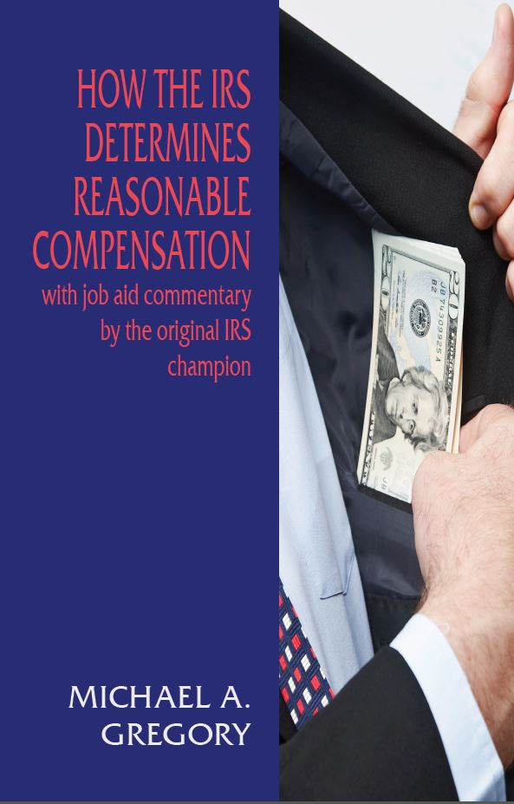
www.mikegreg.com

Slide 36
How the IRS Determines Reasonable Compensation with Commentary by the Original IRS Issue Champion
Part 1 Overview of Reasonable Compensation
  Key Factors and Sources of Information
  The Three Approaches
  Key Issues
  Recommendations
Part 2 IRS Job Aid on Reasonable Compensation with Commentary
  IRS Job Aid on Valuing Non-Controlling Interests on S Corps on the right side
  Comments for Your Consideration Tying Into Part 1 to Clarify and to Assist the Business Valuer on the left side

Slide 37

www.mikegreg.com

Slide 38
Discount for Lack of Marketability and the IRS
Starts the Discount for Lack of Marketability Job Aid for IRS Valuation Professionals Published by the IRS
Supplemented with commentary from modelers critiqued in the original Job Aid
Michael Gregory’s Commentary based on IRS and private sector reviews of scores of reports for expert witnesses
Specific recommendations

Slide 39

www.mikegreg.com

Slide 40
The Wheels Are Falling Off the Wagon at the IRS
Download for free at www.irswheels.com
This Book Has Gone Viral
On reddit 7,500 up votes, 3,500 comments and a million reads
Commentary from Current and Former IRS Employees at All levels
Testimony Before Congress
IRS Statistics
Bottom Line the IRS is in Serious Trouble
This is a National Crises

Slide 41
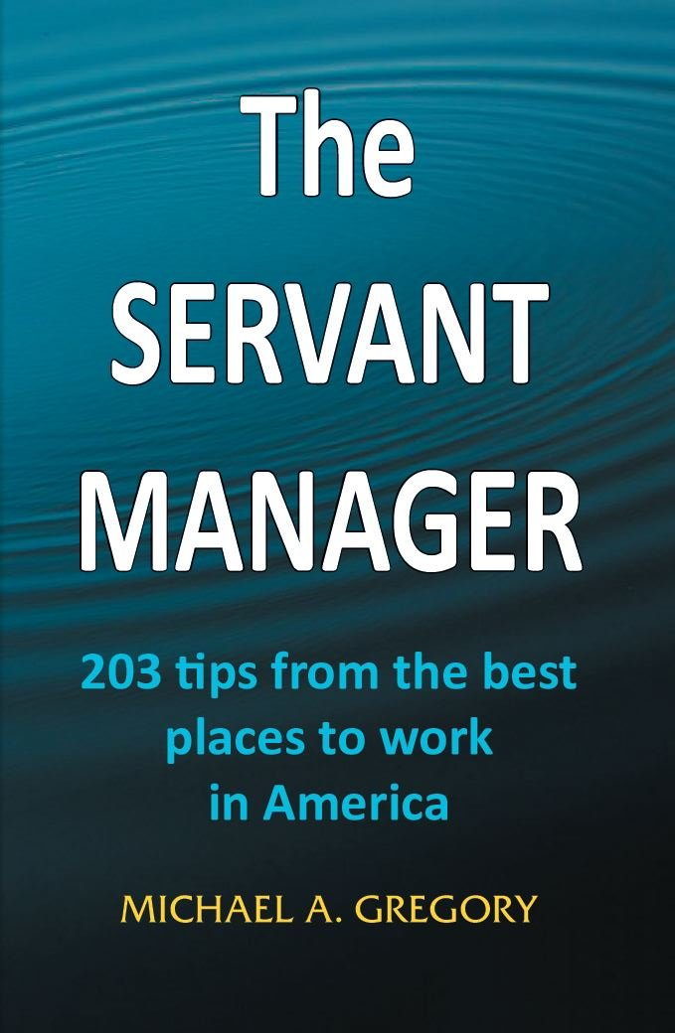
www.mikegreg.com

Slide 42
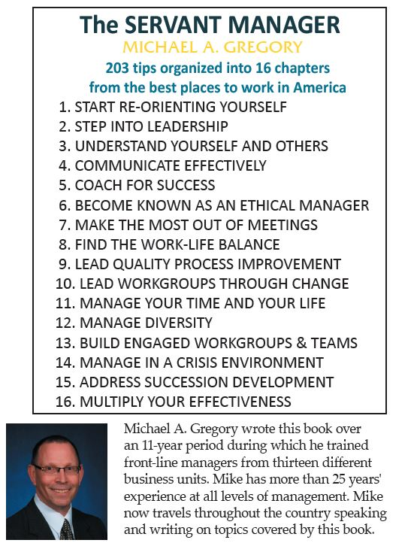
The Servant Manager: 203 tips from the best places to work in America

Slide 43

www.mikegreg.com

Slide 44
Peaceful Resolutions
The Art of De-escalation
The Art of Communication
The Art of Conversation
The Art of Listening
The Art of Discussion
The Art of Negotiation
The Art of Mediation
The Art of Compromise
Virtual Approaches
Keys: Listening; Understanding: Facts, Issues, Emotions, Interests; Respecting One Another

Slide 45

Work Together for Peaceful Resolutions

Slide 46

This is Your Chance to….

Slide 47
Contact Information
Michael Gregory Consulting, LLC
mg@mikegreg.com
www.mikegreg.com
www.mikegreg.com/blog
651-633-5311
Contact me with any questions or concerns

